Slide 1
Statistical Arbitrage in Cryptocurrency markets using principle components analysis

Slide 2
Data
Cryptocompare API
HTML web scraping of Coinmarketcap
Both have shortcomings
Inconsistency between datasets
  Volume, first trade date, price
Coin/USD pairs not readily available. Some coins may only have Coin/BTC or Coin/ETH pairs
Liquidity

Slide 3
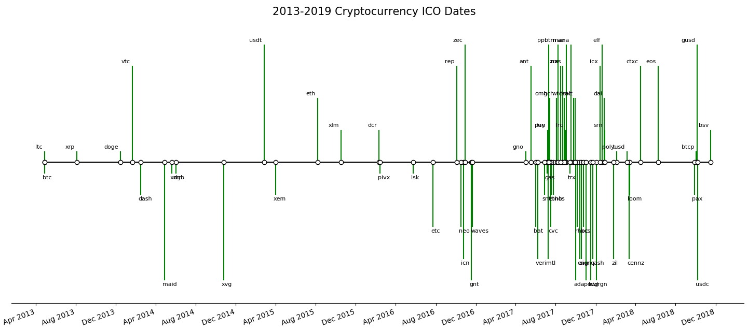
Timeline

Slide 4
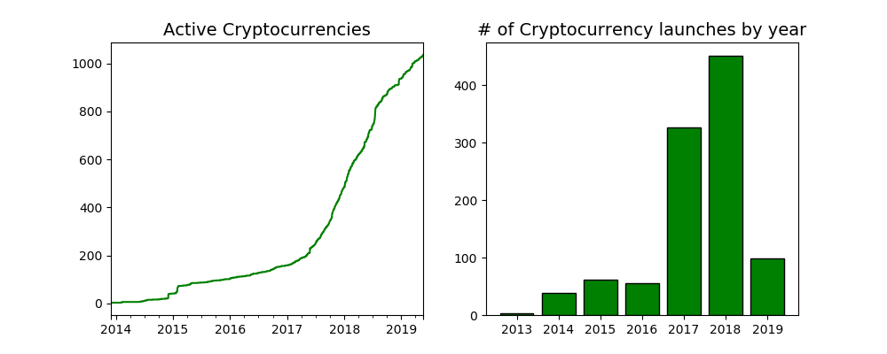
Overview (Full sample)

Slide 5
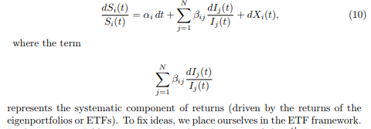

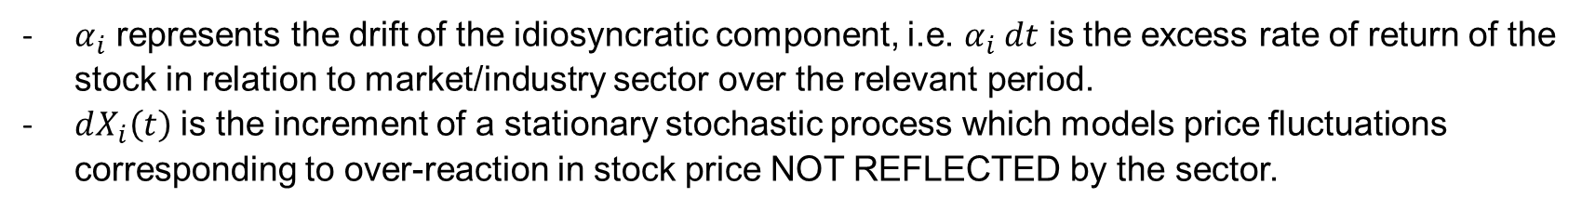
Returns
$α_{i}$ represents the drift of the idiosyncratic component, i.e. $α_{i} dt$ is the excess rate of return of the stock in relation to market/industry sector over the relevant period.
$dX_{i}\left(t\right)$ is the increment of a stationary stochastic process which models price fluctuations corresponding to over-reaction in stock price NOT REFLECTED by the sector.

Slide 6

Pseudocode
Choose sample period. i.e. 2018/1/1 – 2019/5/29
Check which coins have traded for x amount of time(trailing historical window to conduct PCA) before the first date
Establish & rank the eigenvectors and eigenvalues
Select either fixed number of PC’s i.e. 30, or a threshold for variance explained and the corresponding variable number of PC’s (i.e. ~50% variance, ~30 components)
Formulate the eigenportfolio
Notes:
Clean data. Standardize returns so that more volatile coins don’t affect correlation

Slide 7

Estimate regression:
Set:
Take error term from first regression, define auxiliary process as the cumulative sum of these errors:

